Slide 1
Test of non-classical features in interferometry

Slide 2
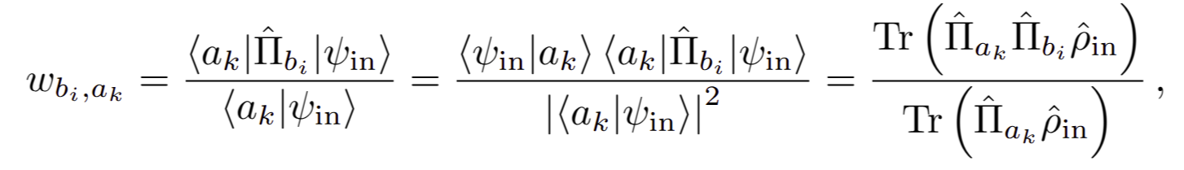
Weak values
Weak-value

Slide 3
Weak values
Weak-value

Slide 4
Weak values
Weak-value

Slide 5
Weak values
Weak-value
Anomalous (real part) ---> negative ---> negative numerator

Slide 6
Weak values
Weak-value
Anomalous (real part) ---> negative ---> negative numerator

Slide 7
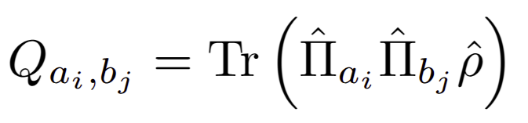
Weak values
KD-distribution
Real part
Imaginary part

